Slide 1
NextJs - Data Fetching and Caching, Revalidating
Subramanian Murugan

Slide 2
Session Content
Caching

Slide 3
What is Caching
Caching is tech through which you can store fun returned value in memory, when next method invocation , we don't need to create frame rather return that value from cache.
Next.js improves your application's performance and reduce costs by caching rendering work and data requests.

Slide 4
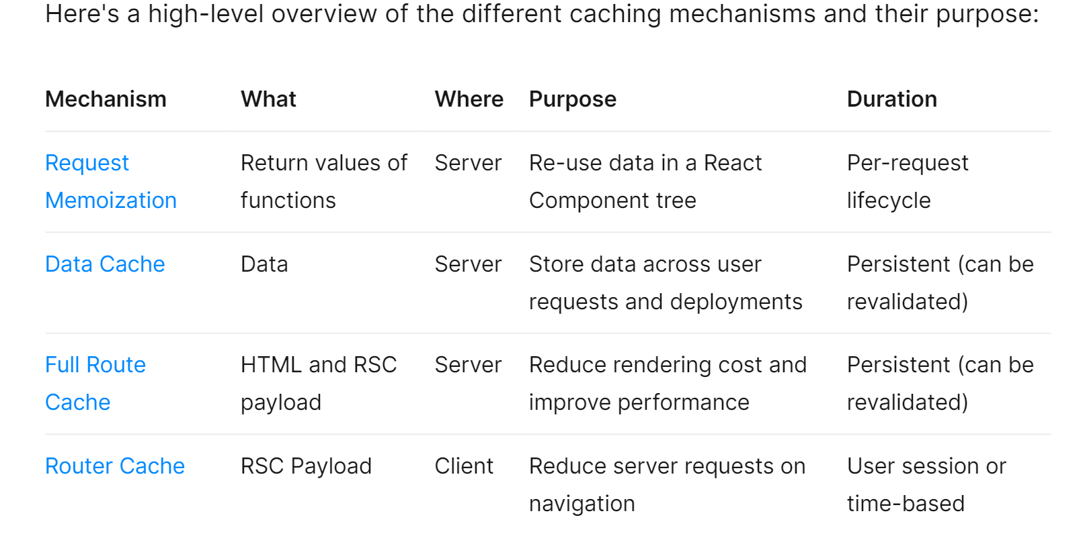

Slide 5
Caching Architecture
By default, Next.js will cache as much as possible to improve performance and reduce cost. This means routes are statically rendered and data requests are cached unless you opt out. The diagram below shows the default caching behavior: when a route is statically rendered at build time and when a static route is first visited.

Slide 6
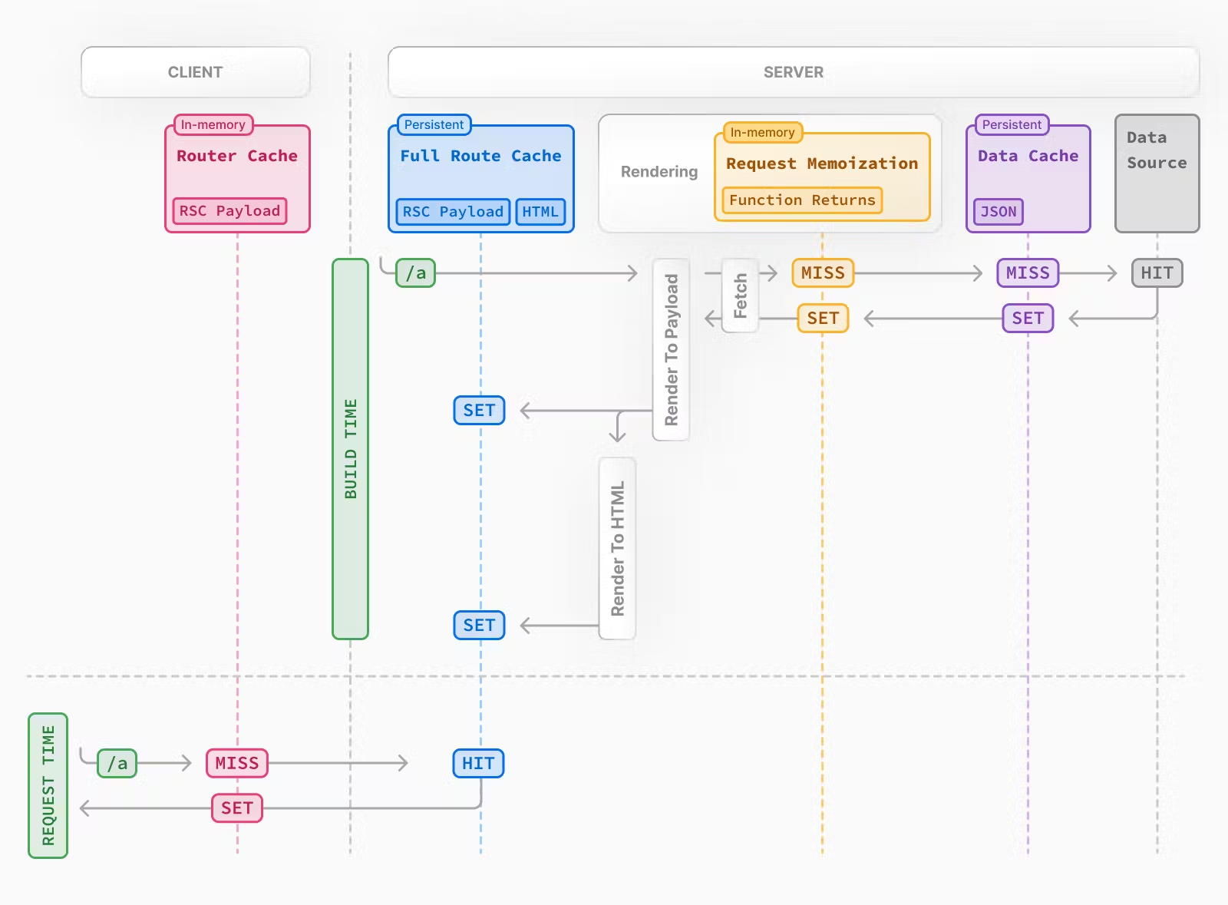

Slide 7
Caching behavior changes depending on whether the route is statically or dynamically rendered, data is cached or uncached, and whether a request is part of an initial visit or a subsequent navigation. Depending on your use case, you can configure the caching behavior for individual routes and data requests

Slide 8
Request Memoization

Slide 9
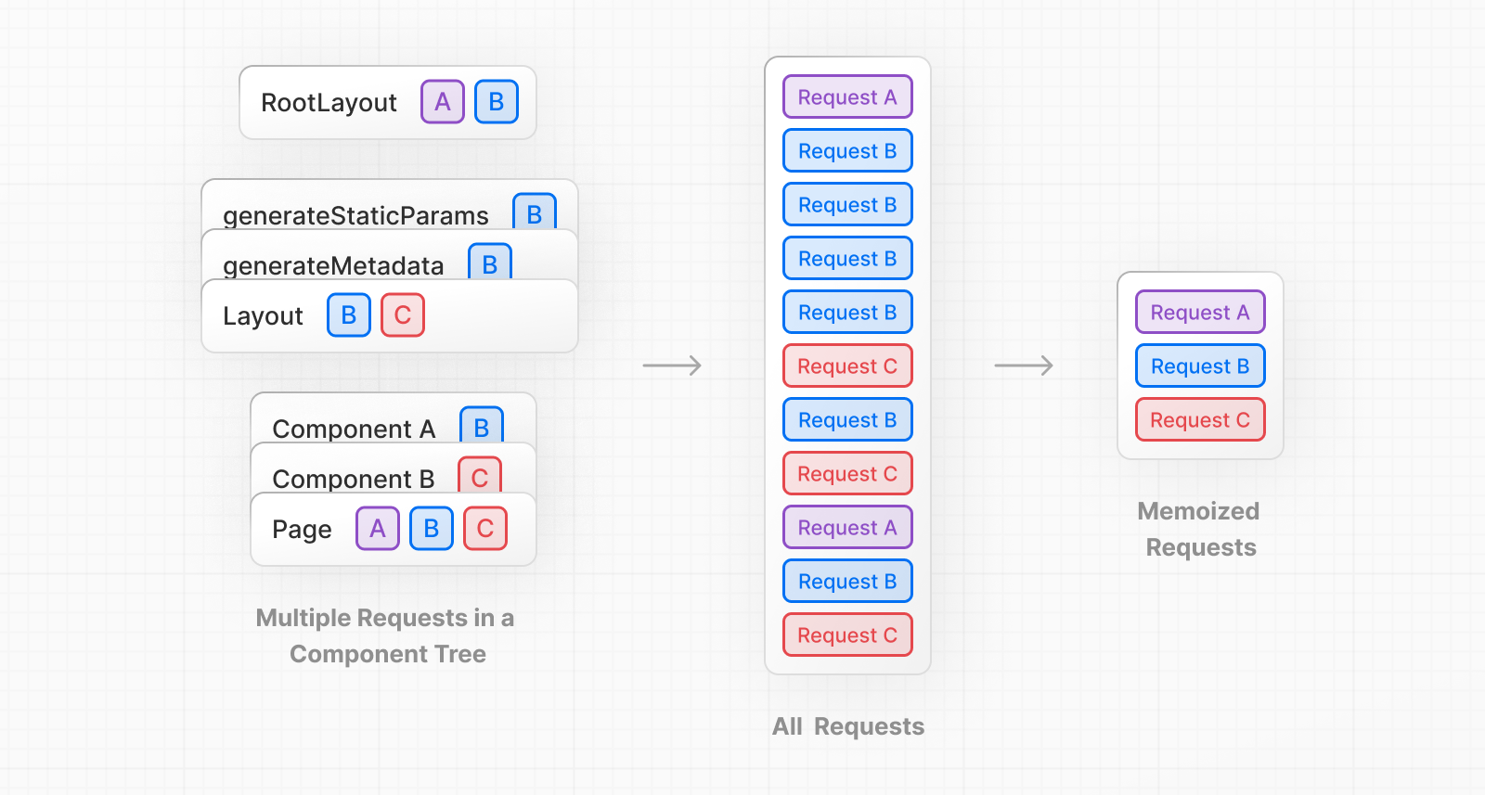

Slide 10
React extends the fetch API to automatically memoize requests that have the same URL and options. This means you can call a fetch function for the same data in multiple places in a React component tree while only executing it once.

Slide 11
if you need to use the same data across a route (e.g. in a Layout, Page, and multiple components), you do not have to fetch data at the top of the tree then forward props between components. Instead, you can fetch data in the components that need it without worrying about the performance implications of making multiple requests across the network for the same data.

Slide 12
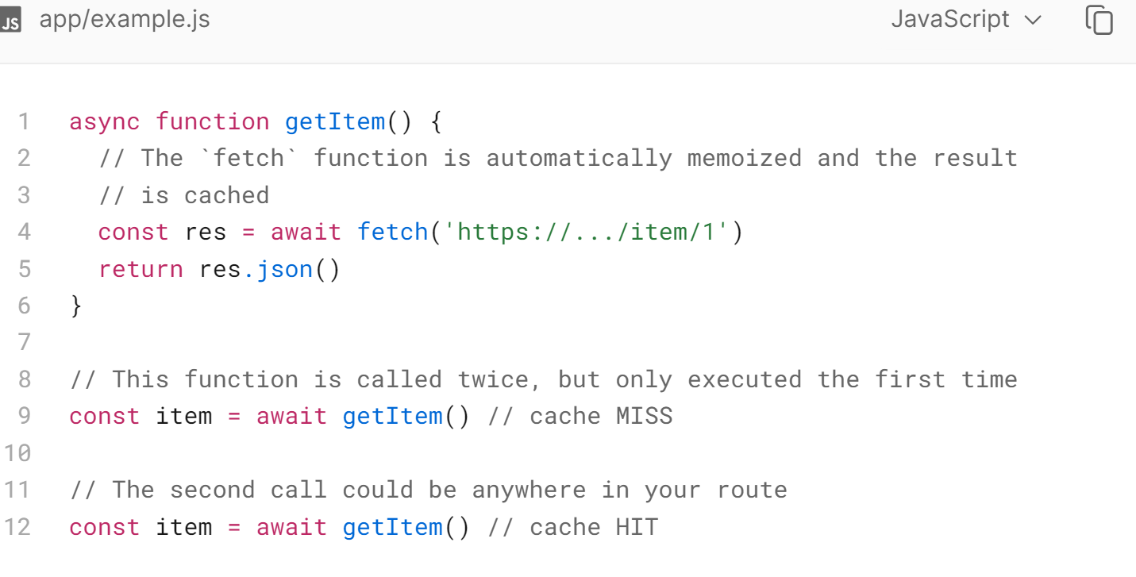

Slide 13
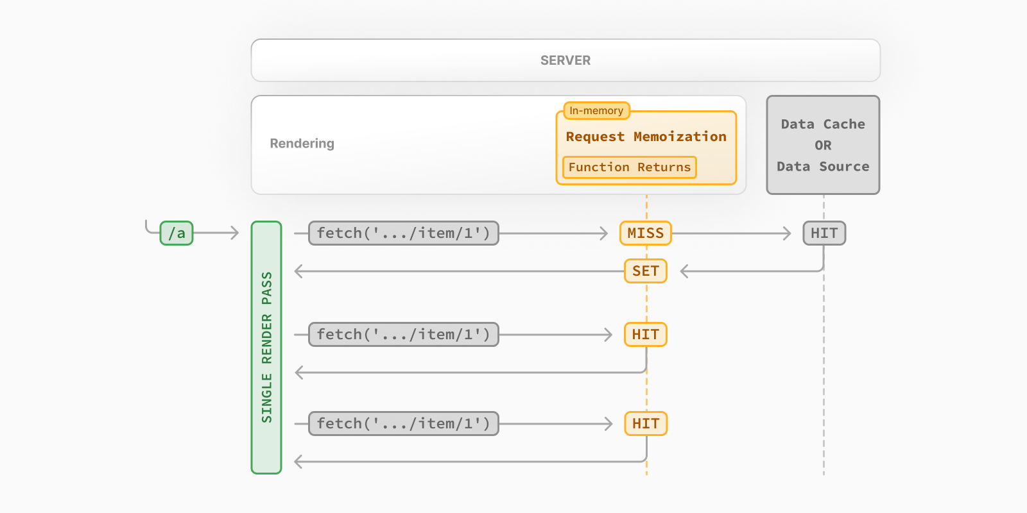

Slide 14
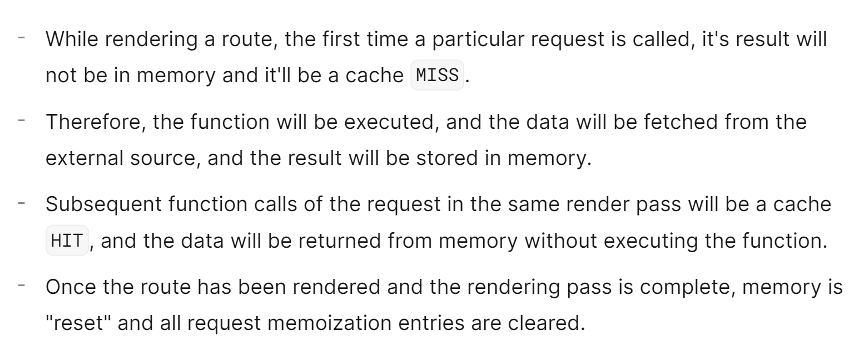

Slide 15
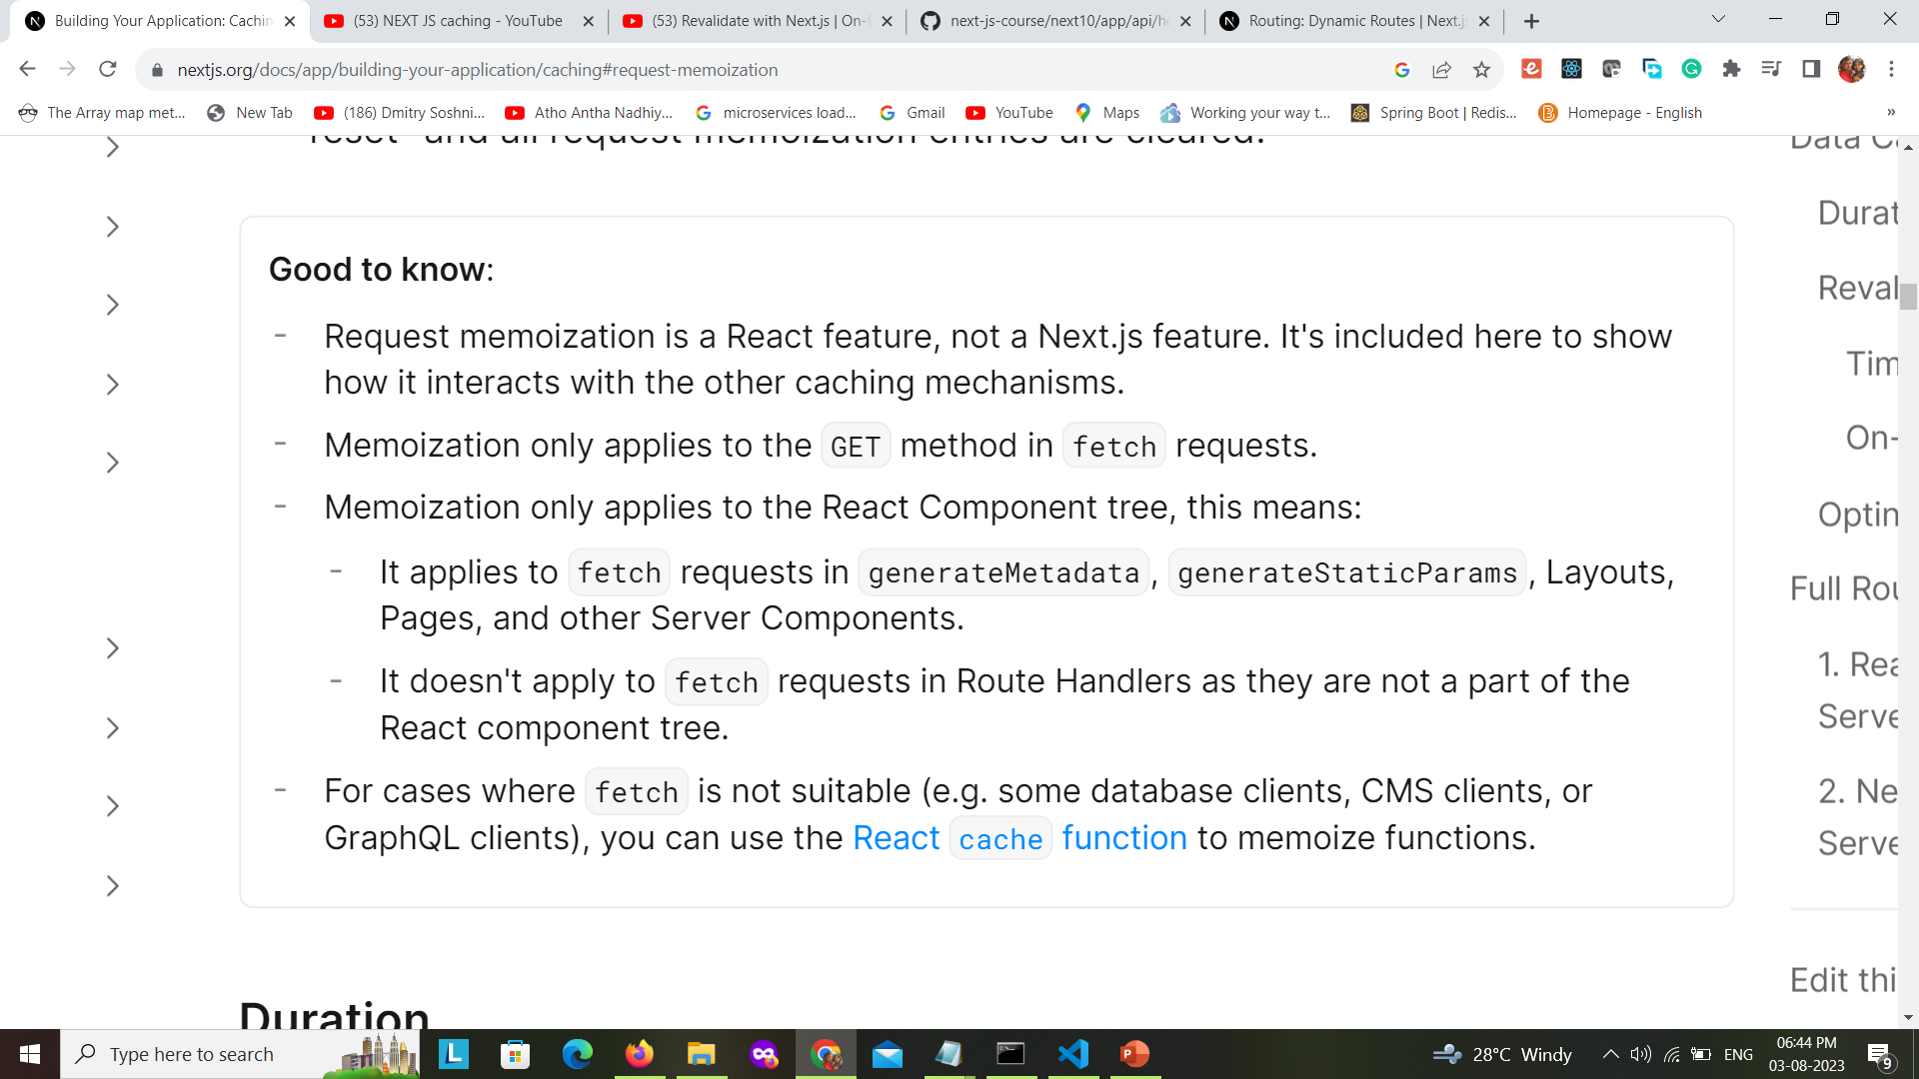

Slide 16
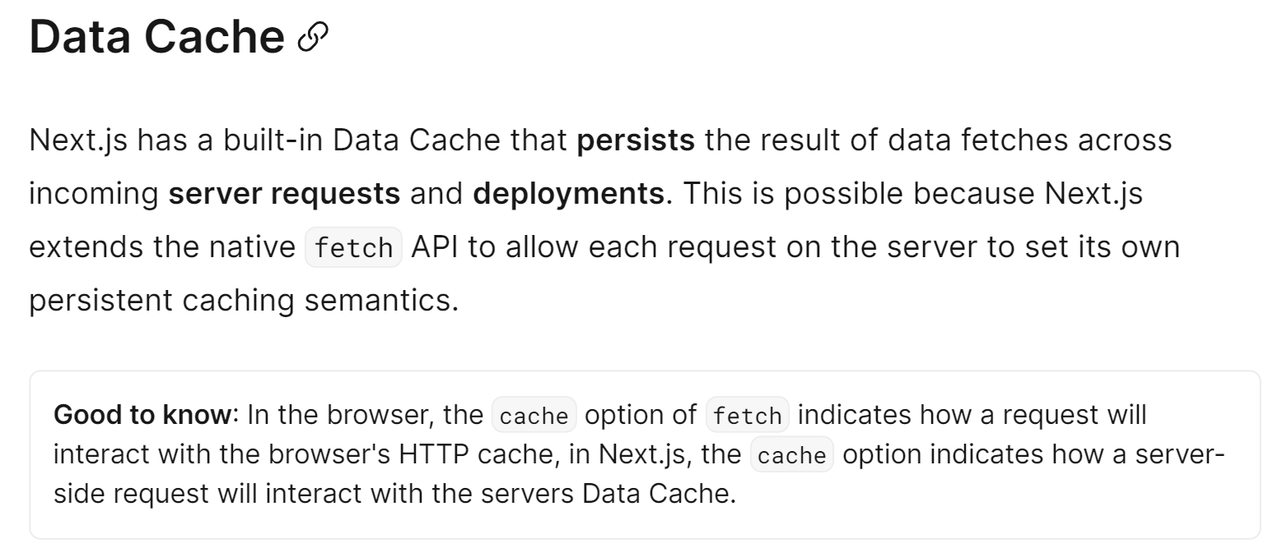

Slide 17
How Data Cache Works

Slide 18
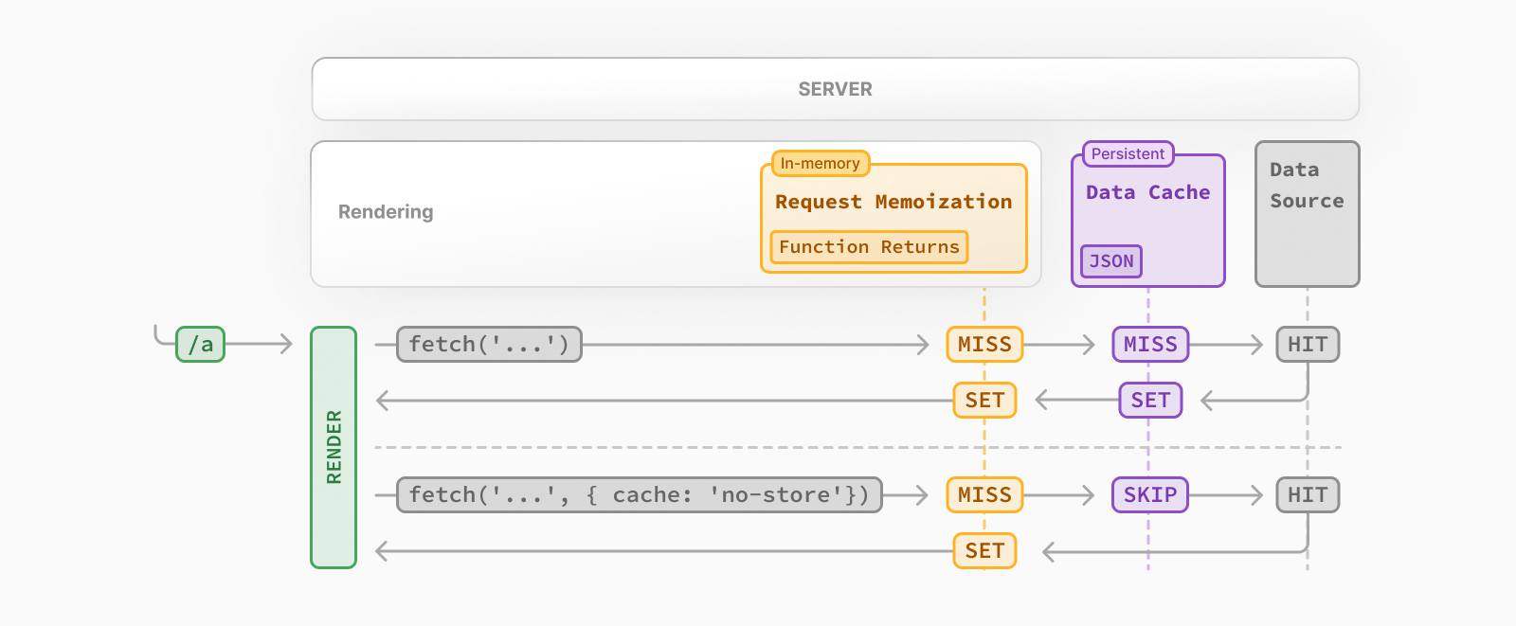

Slide 19
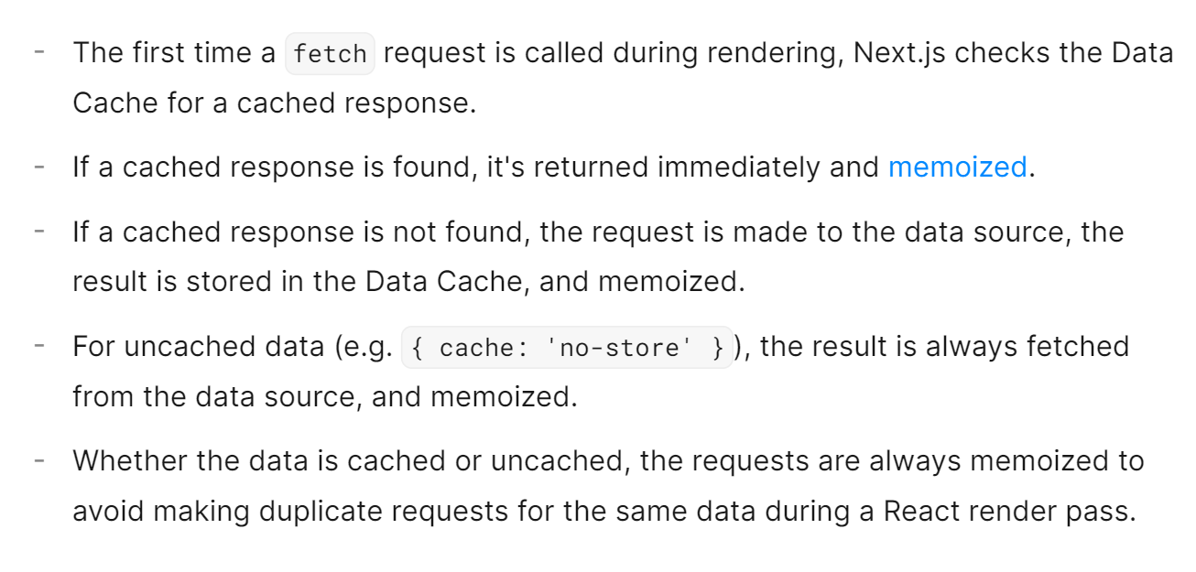

Slide 20
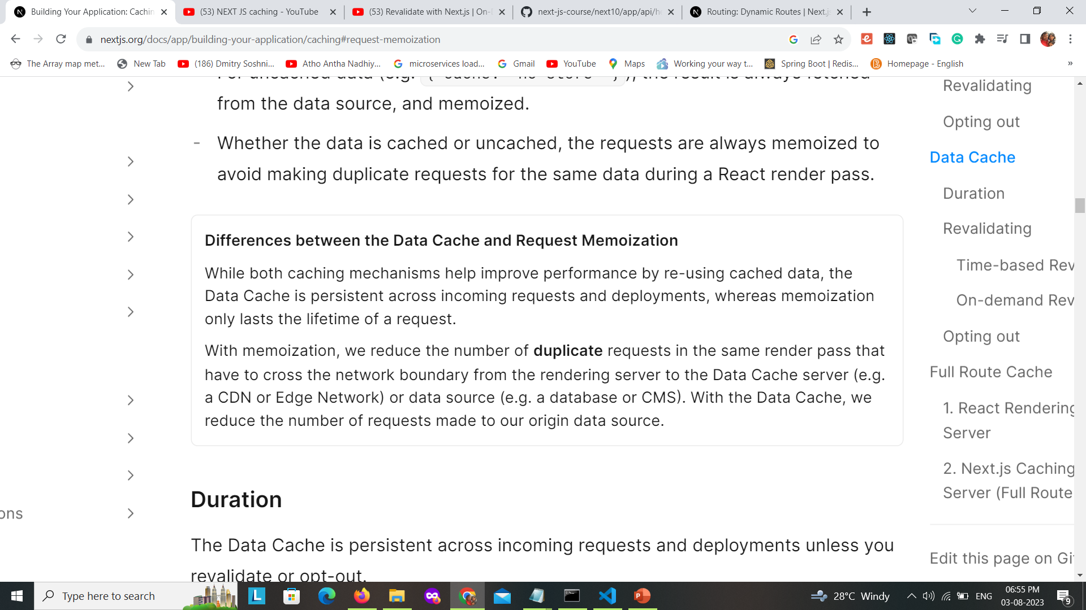
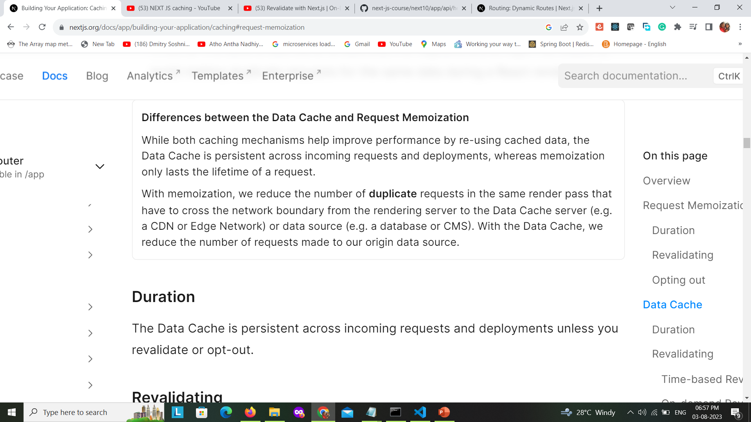

Slide 21
Revalidating Data
Revalidation is the process of purging the Data Cache and re-fetching the latest data. This is useful when your data changes and you want to ensure you show the latest information

Slide 22
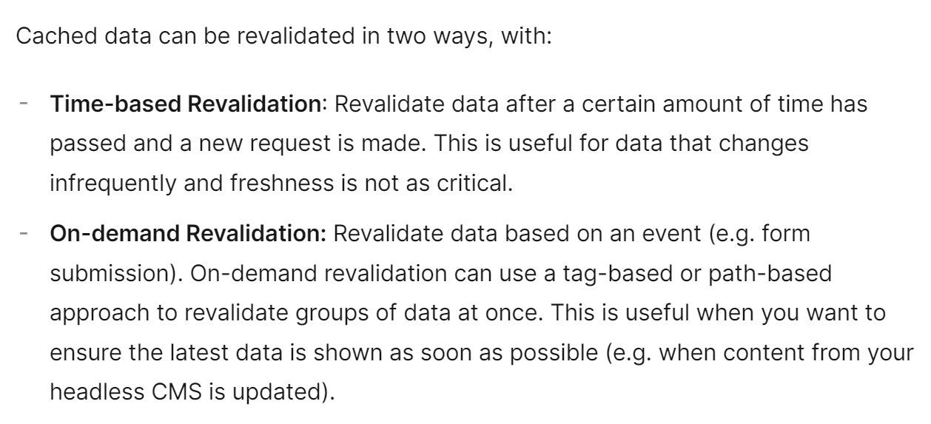

Slide 23
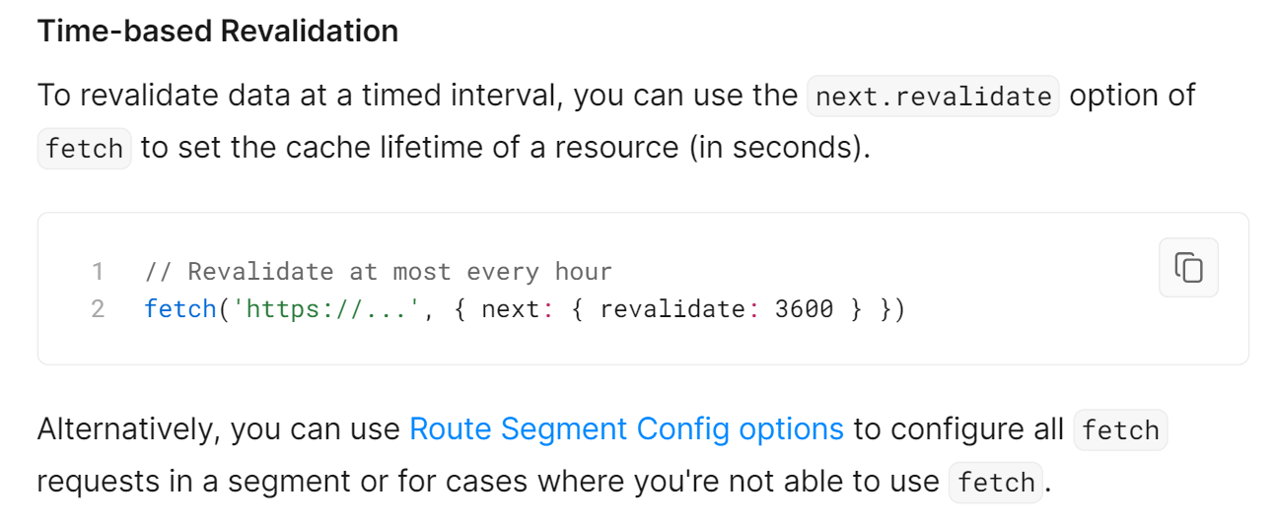

Slide 24
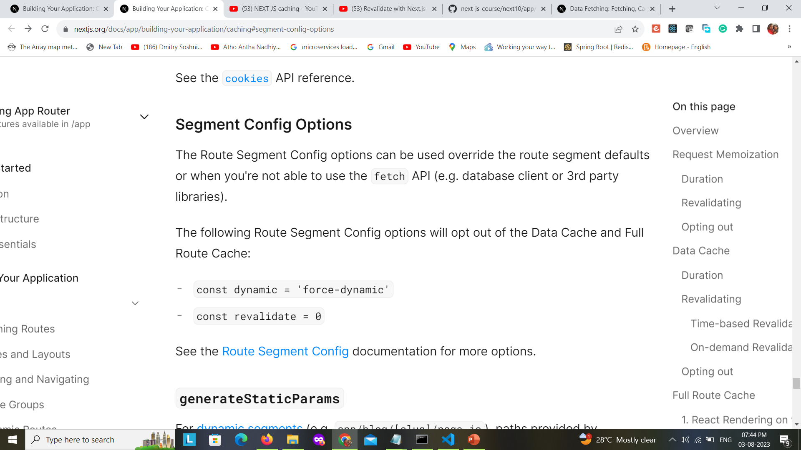
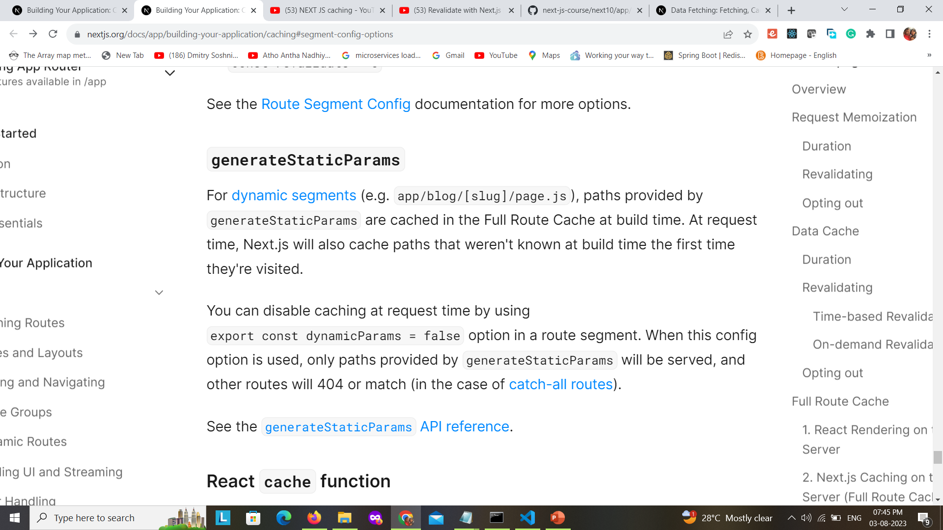

Slide 25
How Time-based Revalidation Works

Slide 26
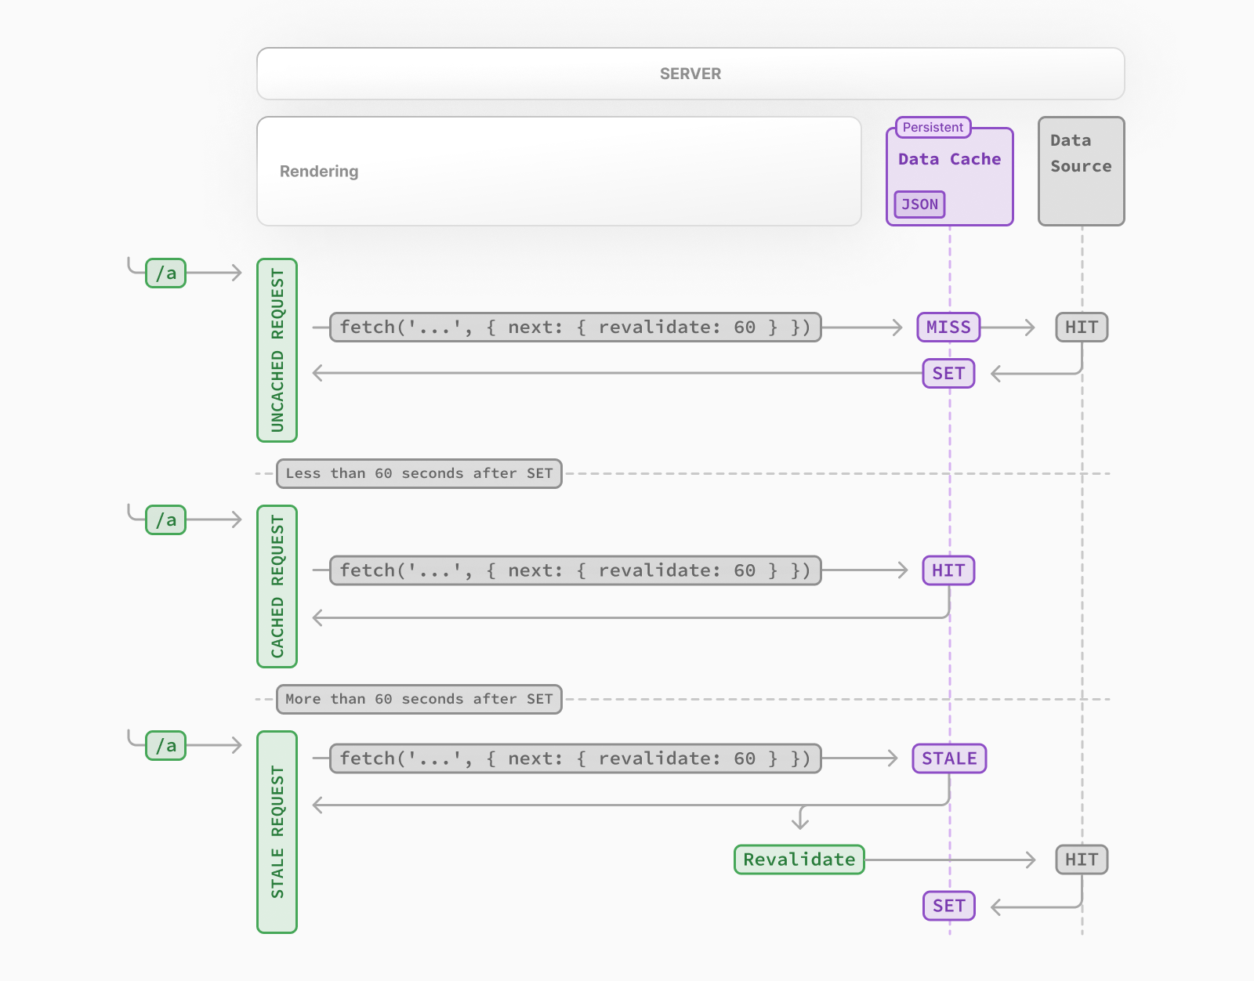

Slide 27
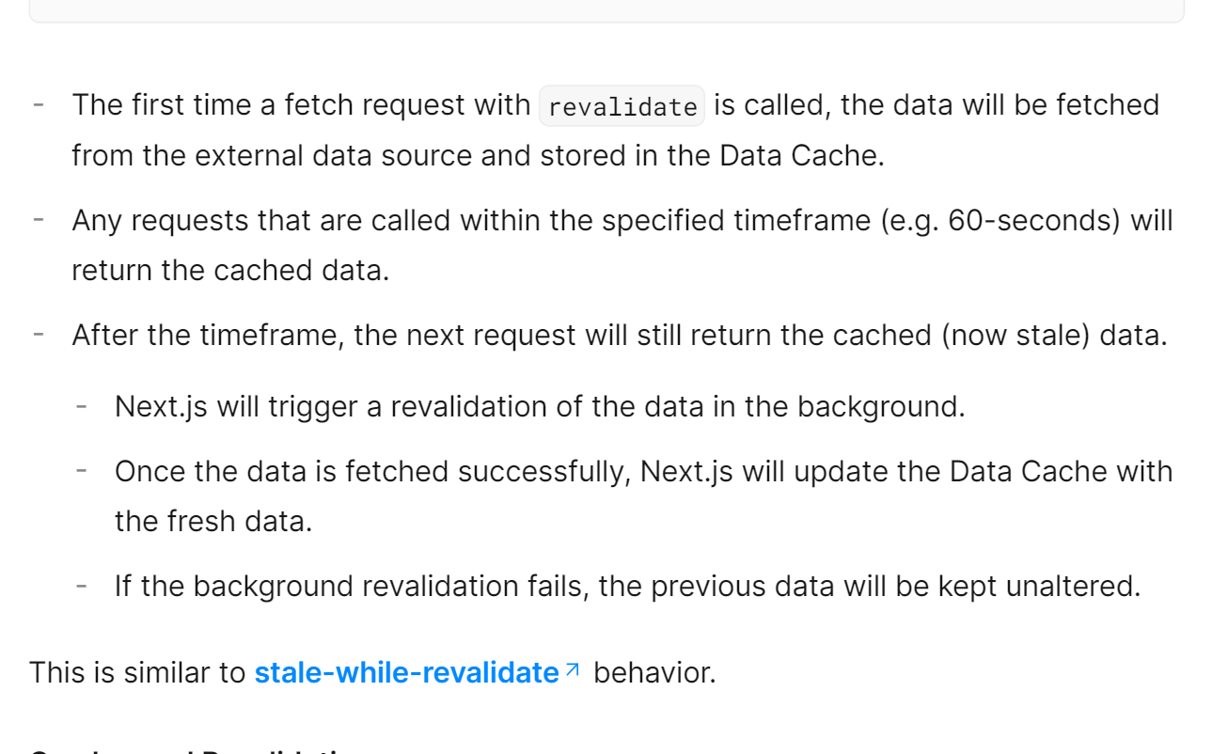

Slide 28
OnDemand Validation

Slide 29
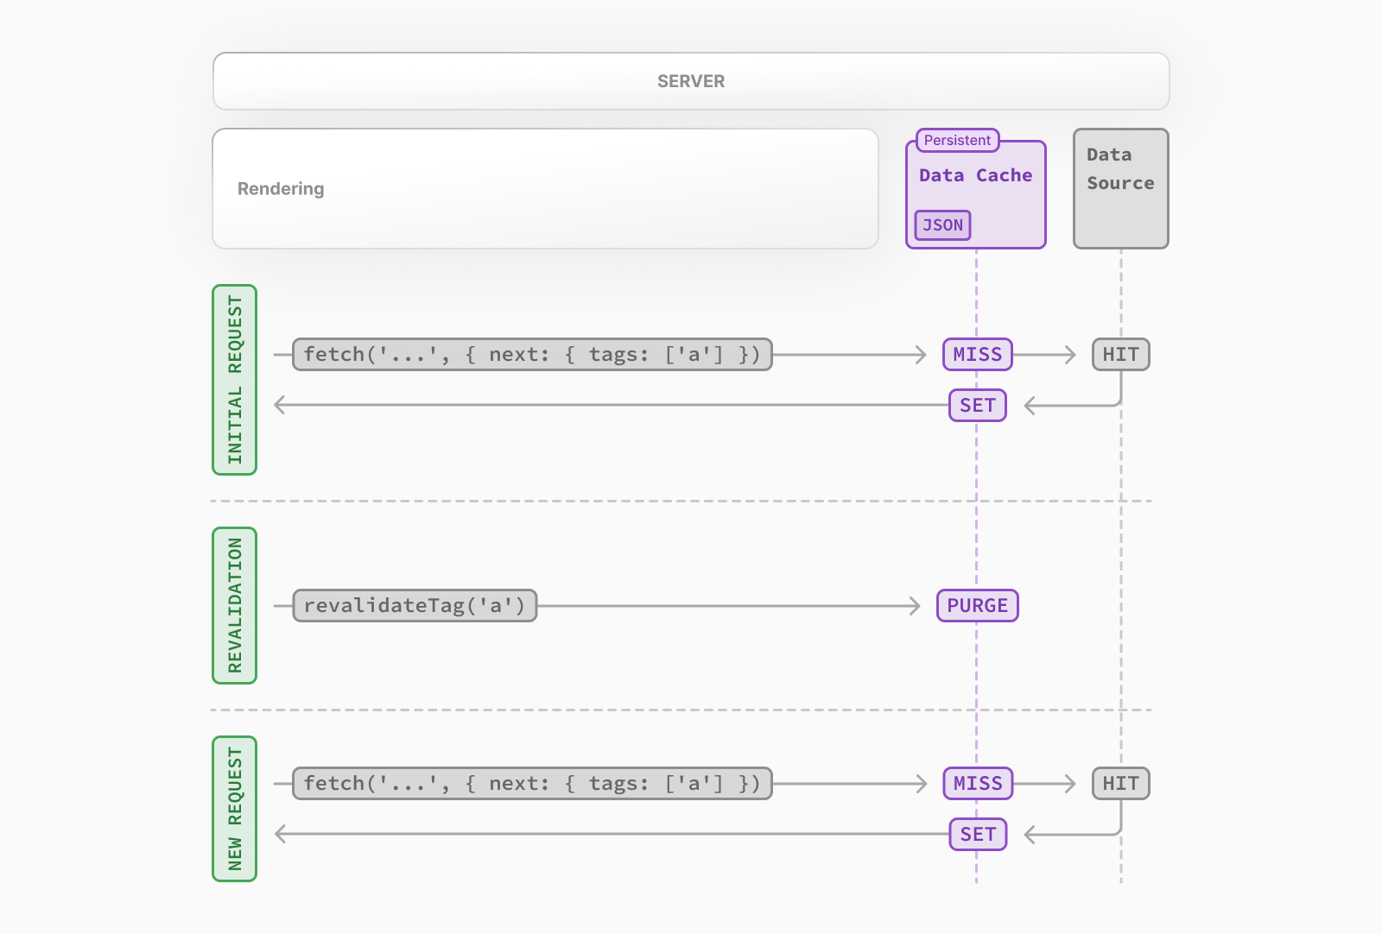

Slide 30
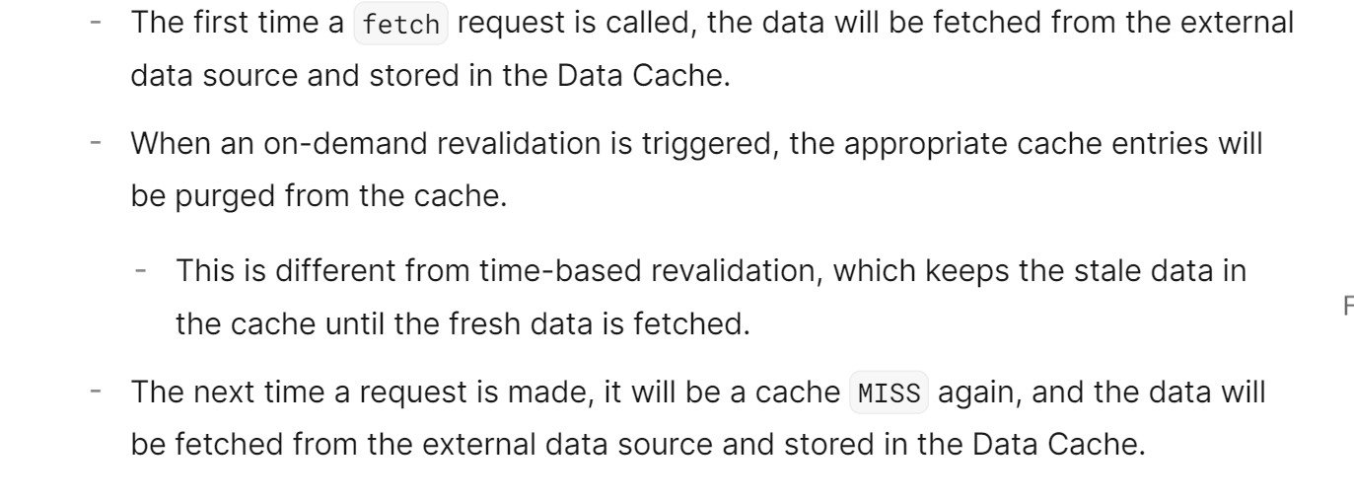

Slide 31
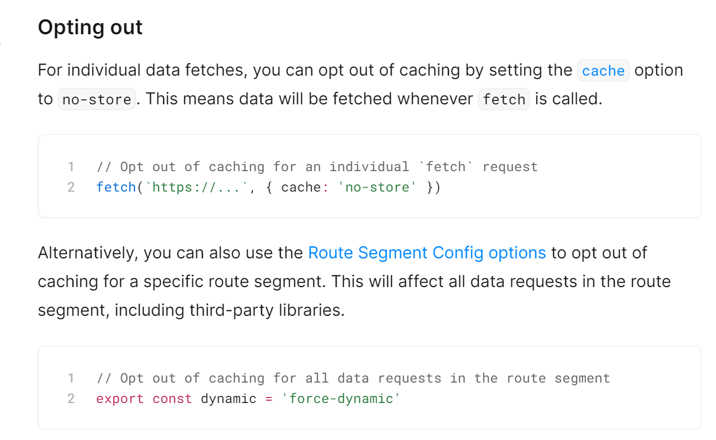

Slide 32
Full Route Cache

Slide 33
The terms Automatic Static Optimization, Static Site Generation, or Static Rendering being used interchangeably to refer to the process of rendering and caching routes of your application at build time.

Slide 34
Next.js automatically renders and caches routes at build time. This is an optimization that allows you to serve the cached route instead of rendering on the server for every request, resulting in faster page loads.

Slide 35
To understand how the Full Route Cache works, it's helpful to look at how React handles rendering, and how Next.js caches the result

Slide 36
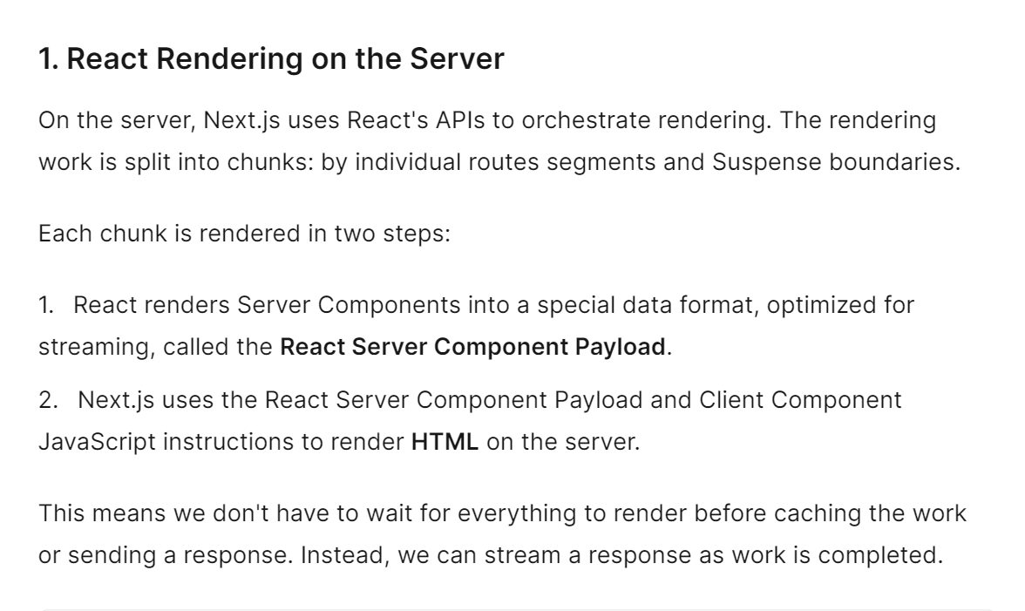

Slide 37
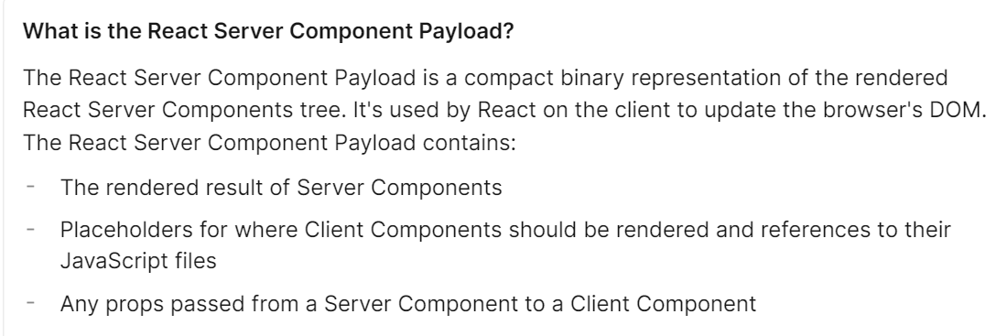

Slide 38
Nexjs Caching on the Server
Full Route Cache

Slide 39
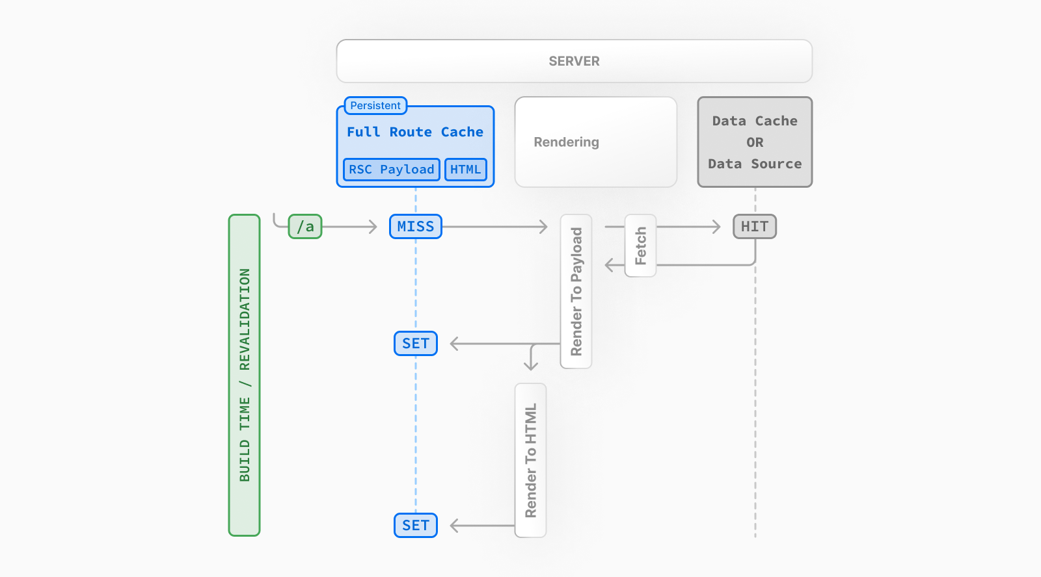

Slide 40
The default behavior of Next.js is to cache the rendered result (React Server Component Payload and HTML) of a route on the server. This applies to statically rendered routes at build time, or during revalidation.

Slide 41
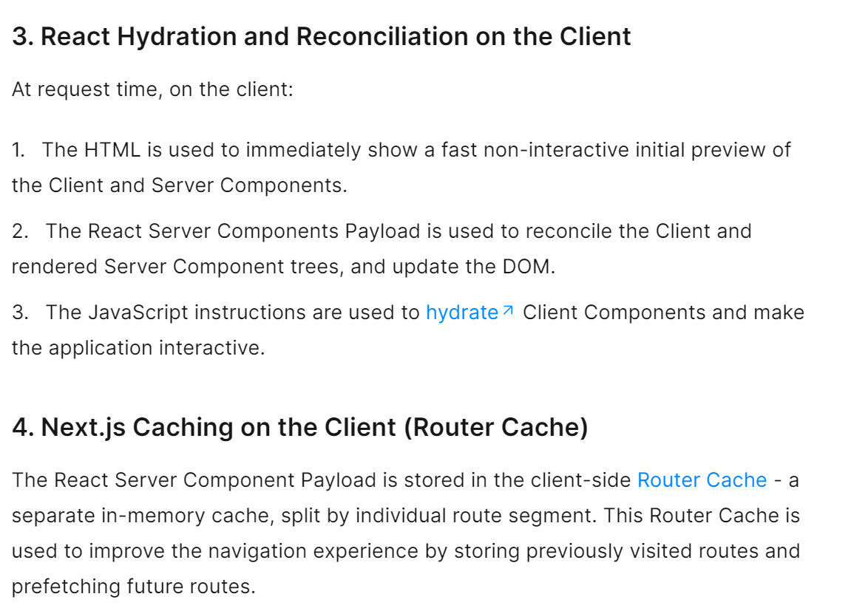

Slide 42
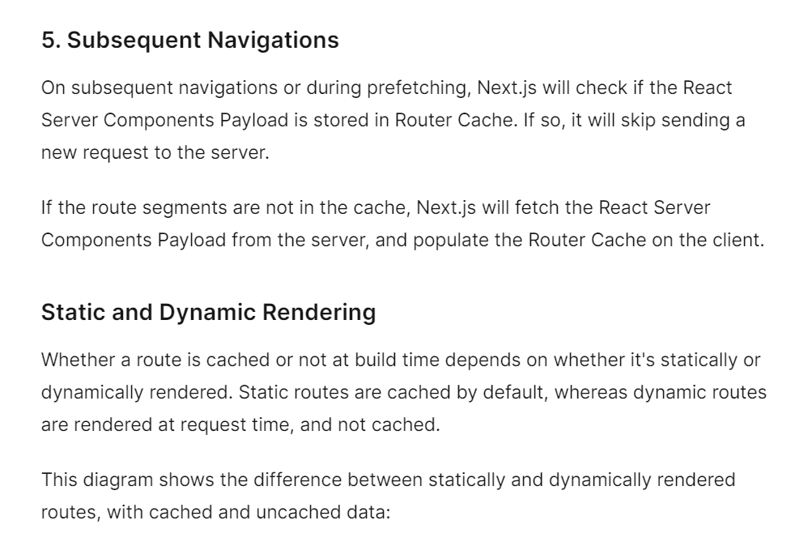

Slide 43
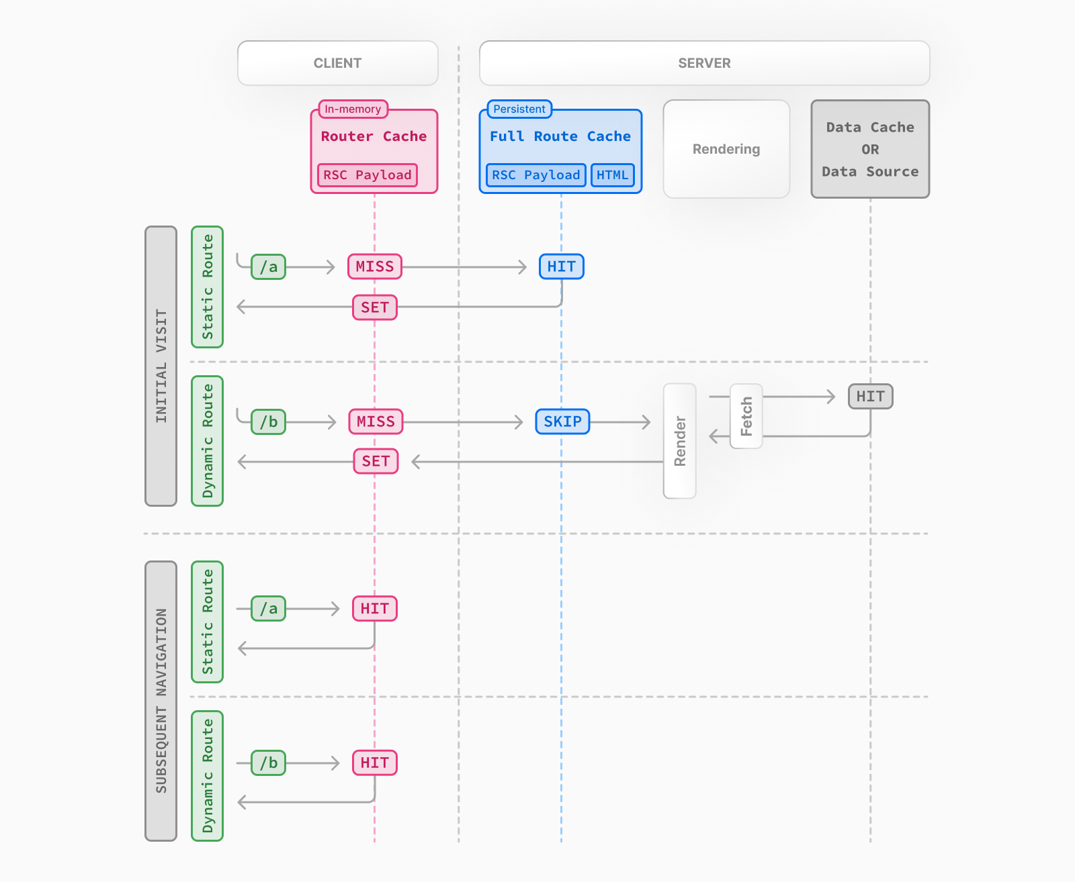

Slide 44
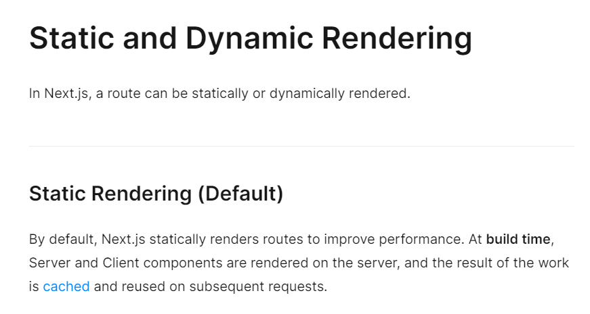
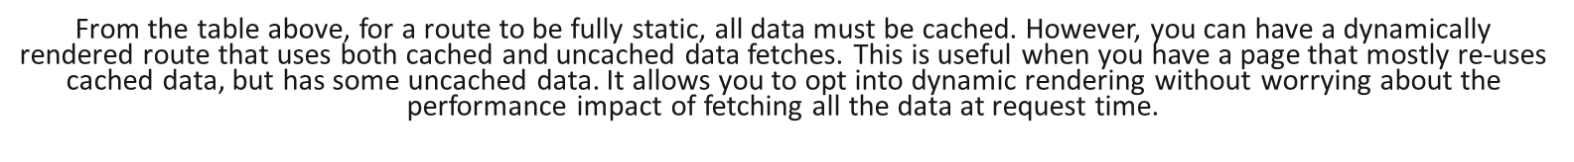

Slide 45
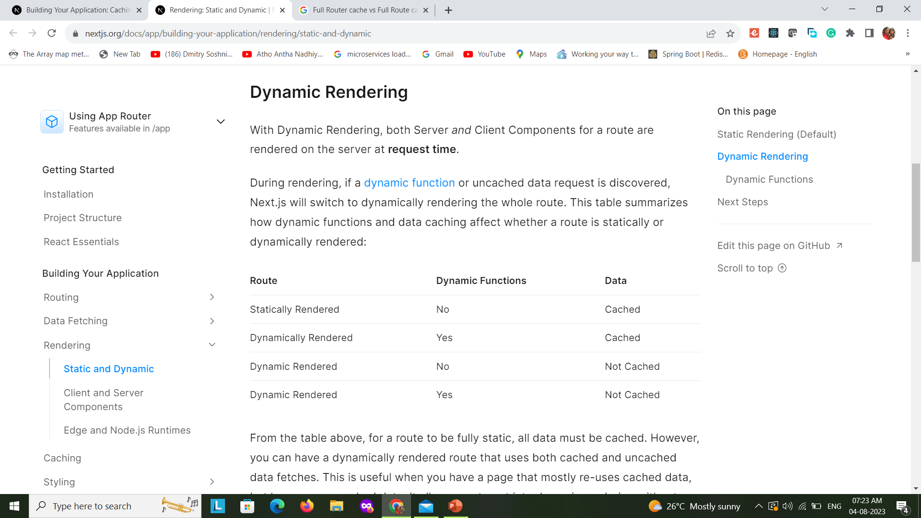
From the table above, for a route to be fully static, all data must be cached. However, you can have a dynamically rendered route that uses both cached and uncached data fetches. This is useful when you have a page that mostly re-uses cached data, but has some uncached data. It allows you to opt into dynamic rendering without worrying about the performance impact of fetching all the data at request time.

Slide 46
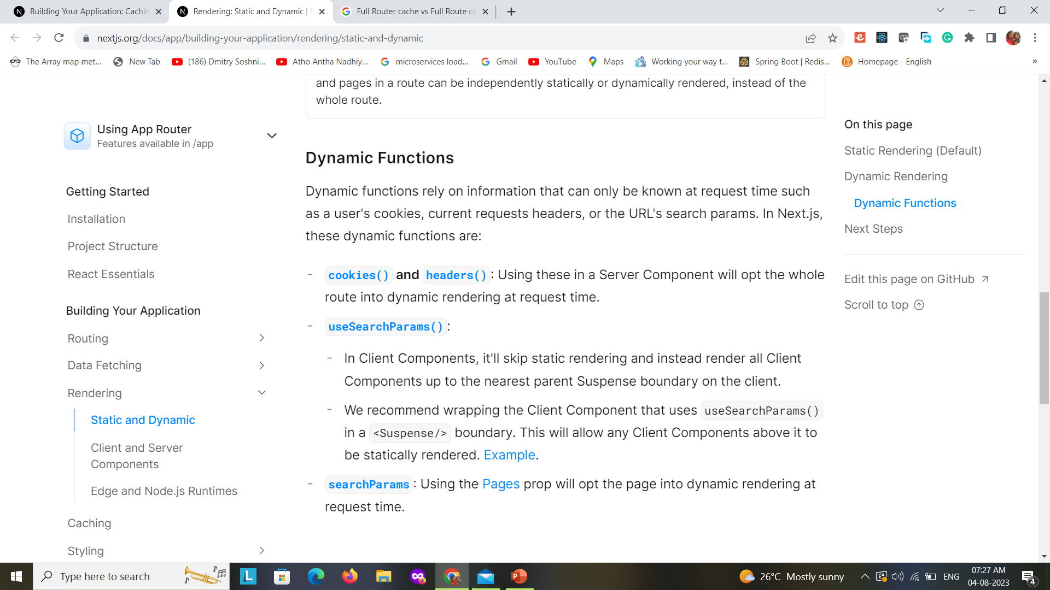

Slide 47
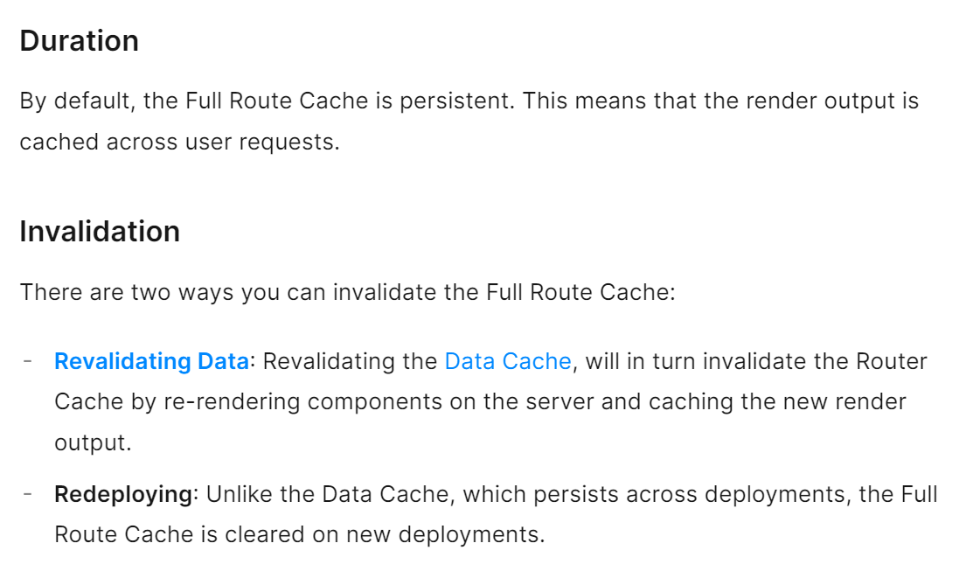

Slide 48
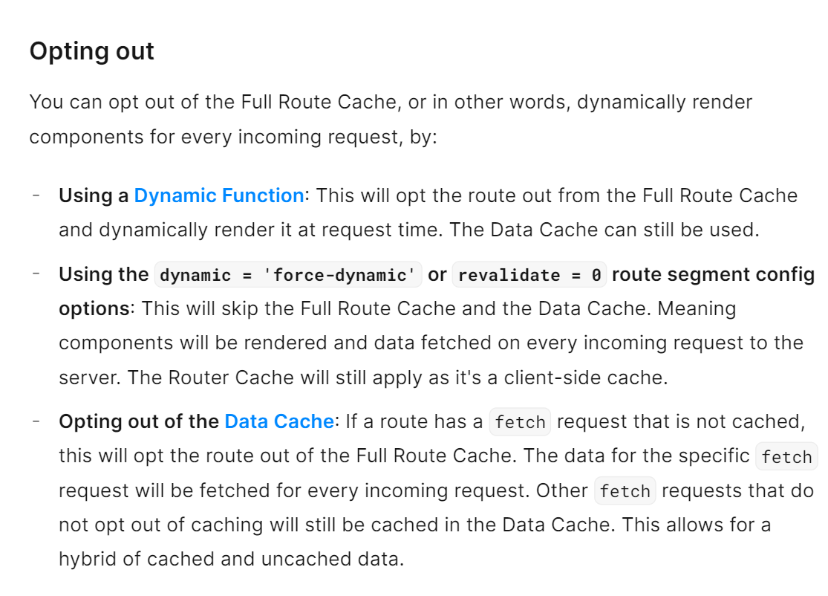

Slide 49
Router Cache(Client Side)

Slide 50
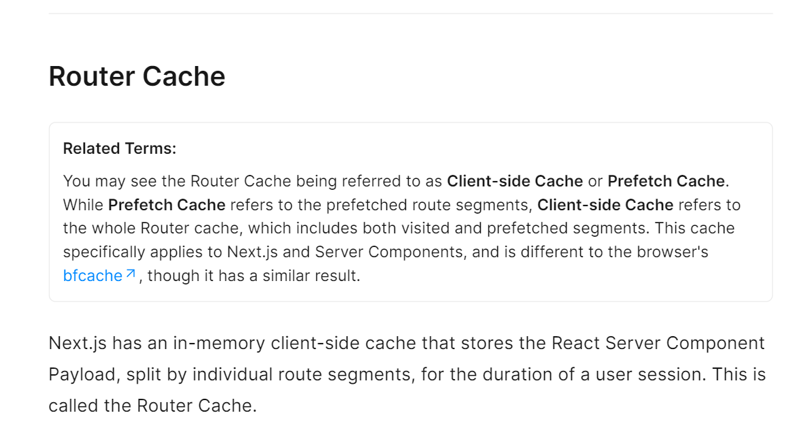

Slide 51
How the Router Cache Works

Slide 52
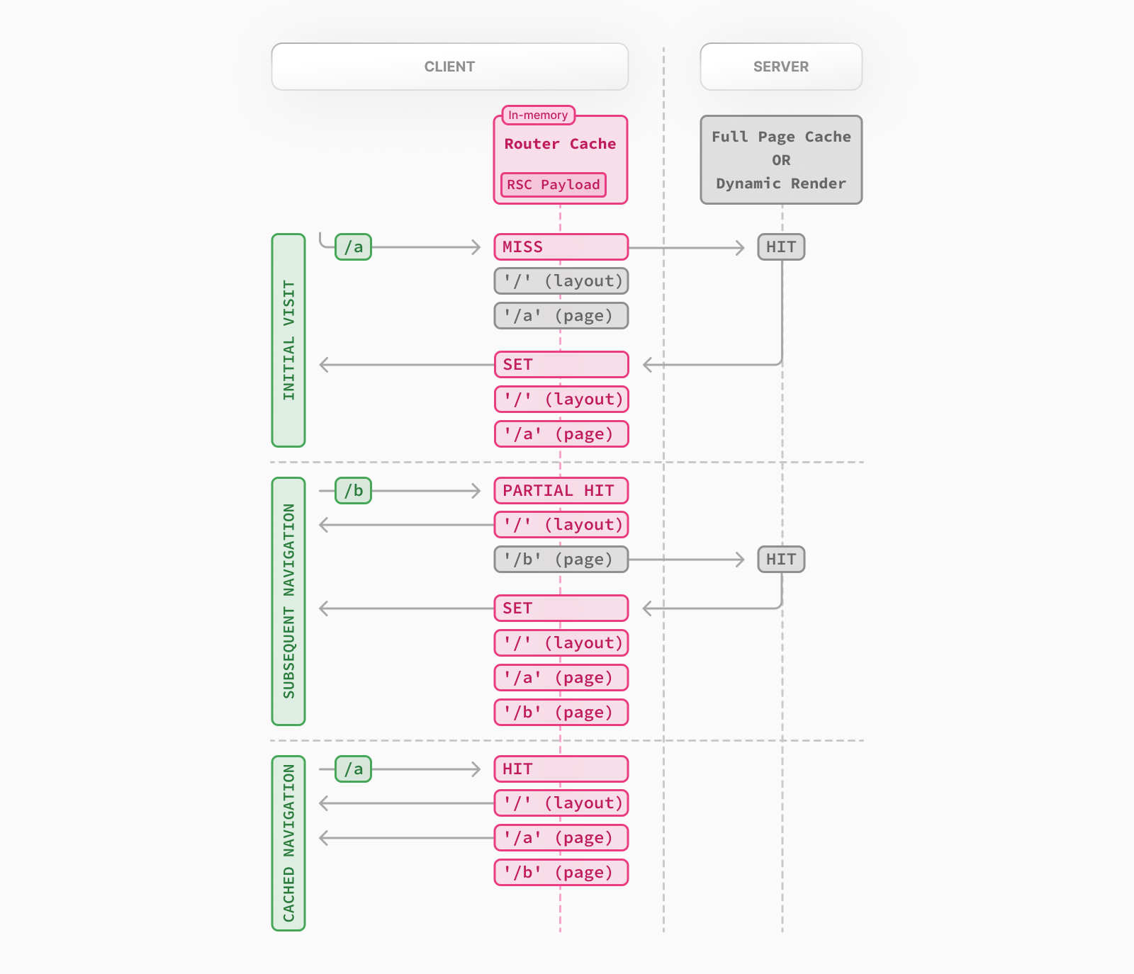

Slide 53
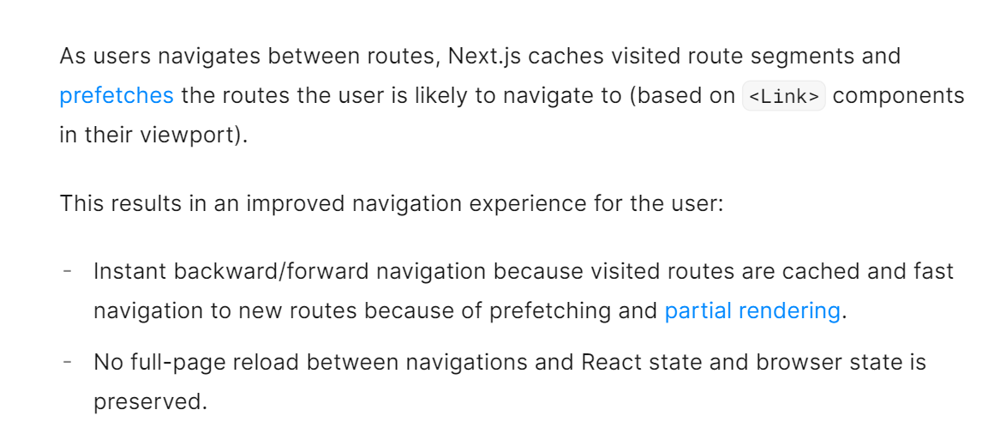

Slide 54
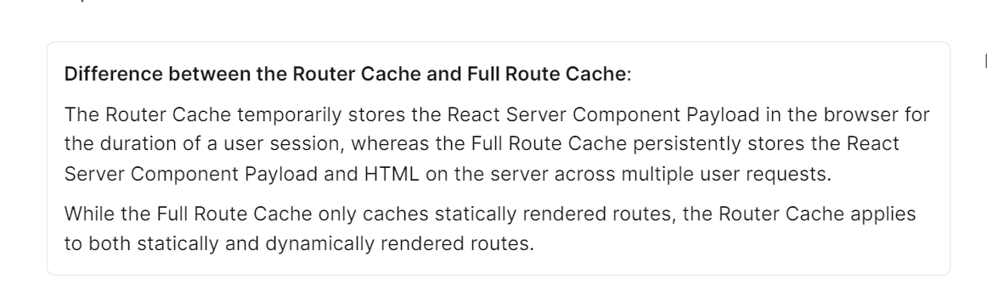

Slide 55
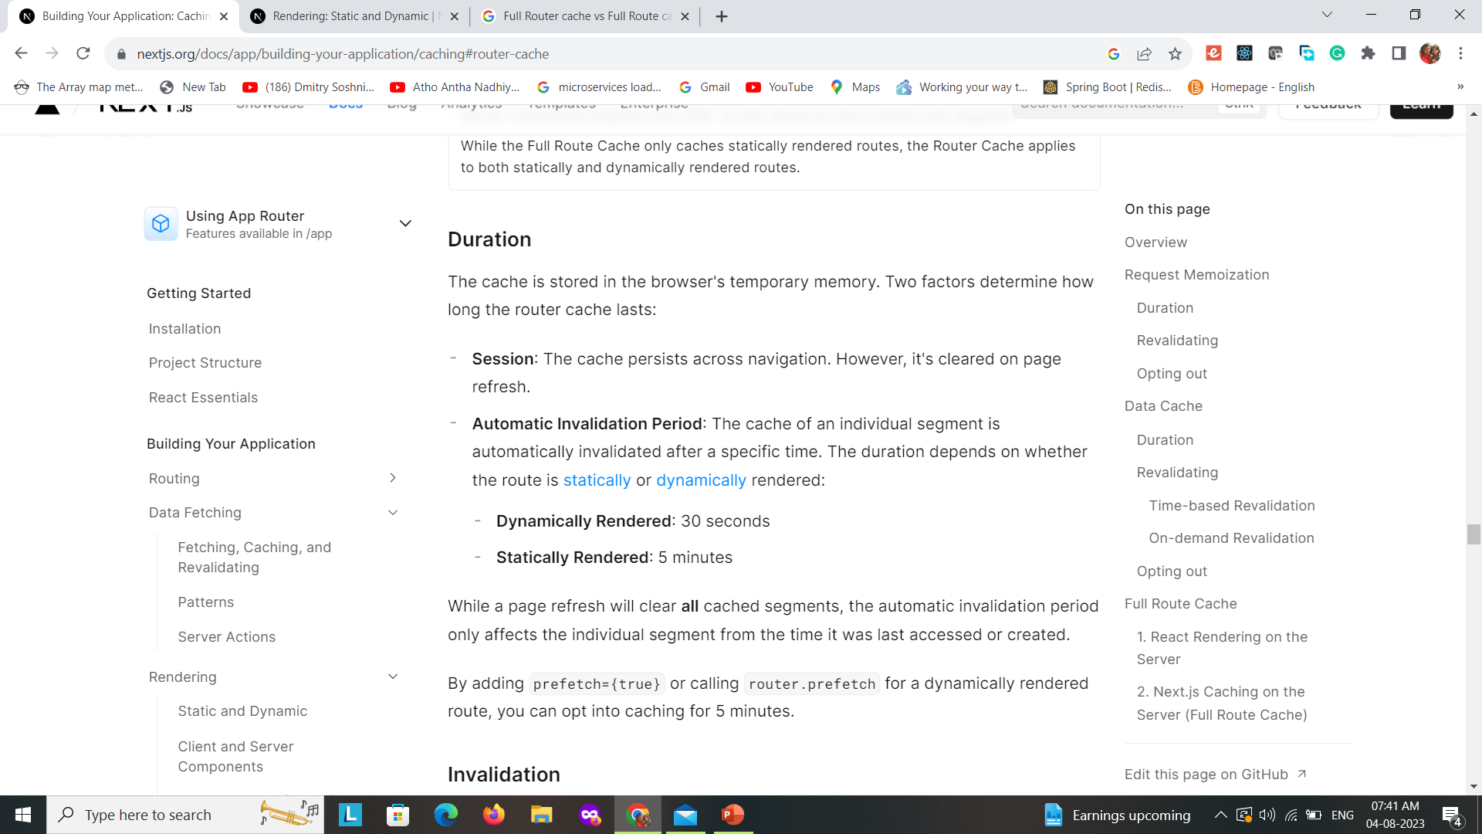

Slide 56
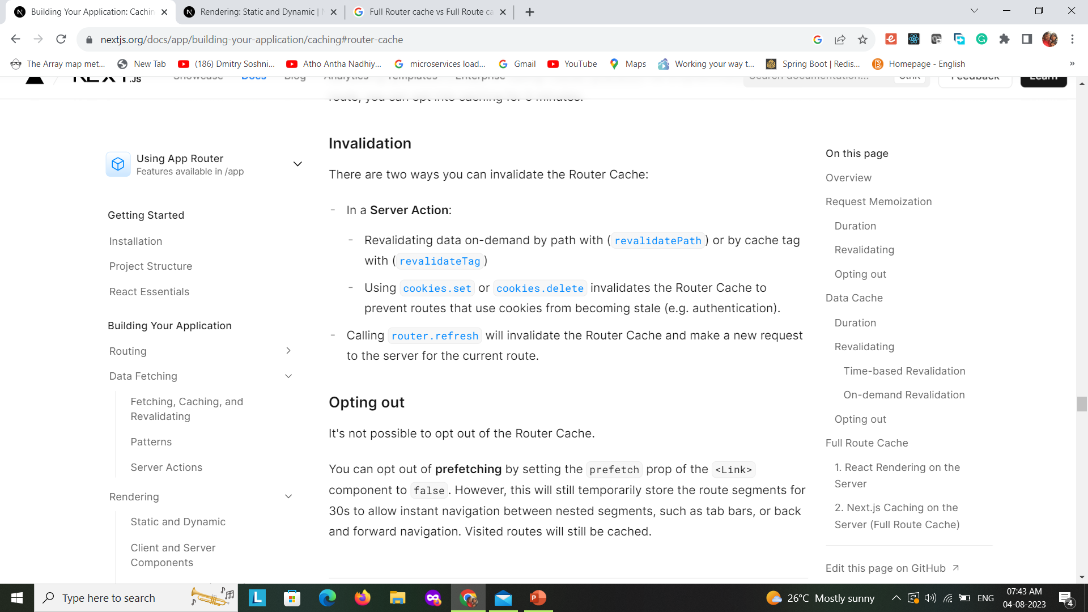

Slide 57
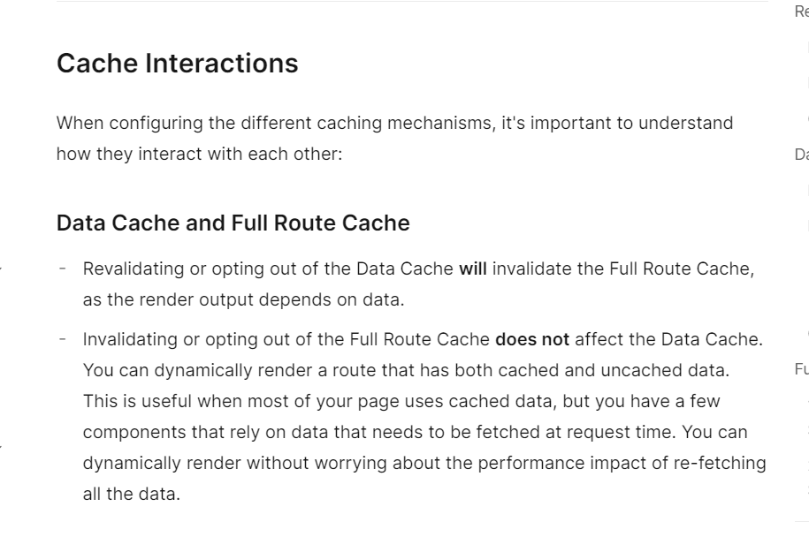

Slide 58
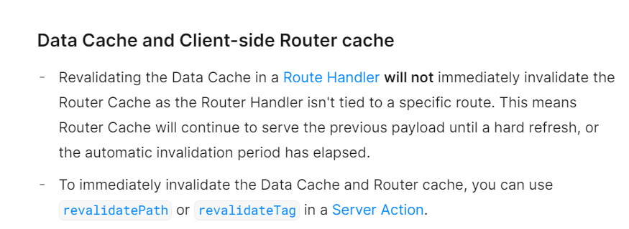

Slide 59
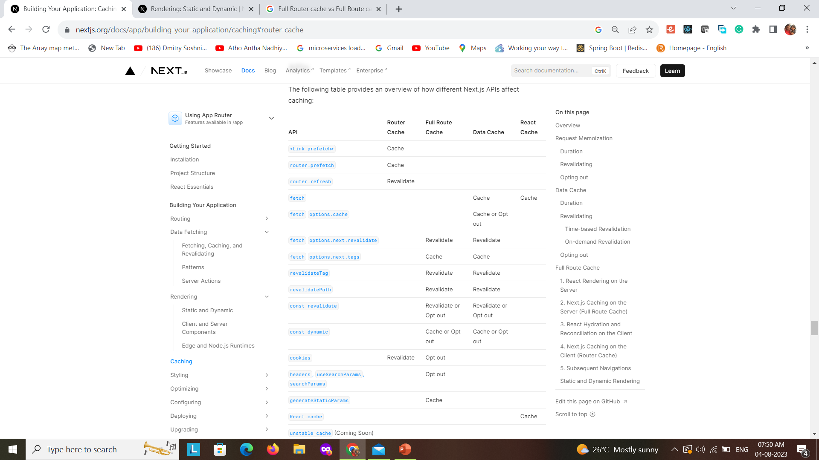

Slide 60
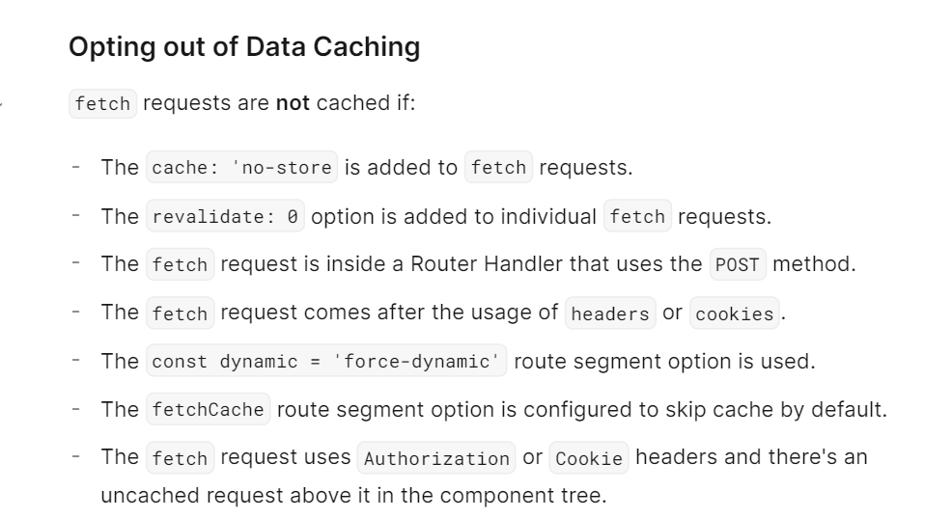

Slide 61
// export const revalidate = 5
export default async function ISRDetails(props) {
// const response = await fetch(`http://worldtimeapi.org/api/timezone/Asia/${props.params.city}`,{ next: { revalidate: 10 } });
// const response = await fetch(`http://worldtimeapi.org/api/timezone/Asia/${props.params.city}`);
const response = await fetch(`http://worldtimeapi.org/api/timezone/Asia/${props.params.city}`, { next: { tags: ['collection'] } });
const data = await response.json();
return <>
{/* <h1>ISR Details page {JSON.stringify(props)}</h1> */}
<h1>Time now :{new Date(data.datetime).toLocaleTimeString()} </h1>
{/* <h1>{data.datetime}</h1> */}
</>
}
export async function generateStaticParams() {
return [{ city: 'Kolkata' }];
}

Slide 62
import { NextRequest, NextResponse } from 'next/server';
import { revalidatePath, revalidateTag } from 'next/cache';
export async function GET(request) {
const path = request.nextUrl.searchParams.get('path') || '/timecache/[city]';
const collection =
request.nextUrl.searchParams.get('collection') || 'collection';
revalidatePath(path);
revalidateTag(collection);
console.log('revalidated', path, collection);
// console.log('revalidated', path);
return NextResponse.json({
revalidated: true,
now: Date.now(),
cache: 'no-store',
});
}

Slide 63
Data Fetching Patterns

Slide 64


Slide 65
Water fall
Parallel and Sequential Data Fetching

Slide 66
With sequential data fetching, requests in a route are dependent on each other and therefore create waterfalls. There may be cases where you want this pattern because one fetch depends on the result of the other, or you want a condition to be satisfied before the next fetch to save resources. However, this behavior can also be unintentional and lead to longer loading times. With parallel data fetching, requests in a route are eagerly initiated and will load data at the same time. This reduces client-server waterfalls and the total time it takes to load data.

Slide 67
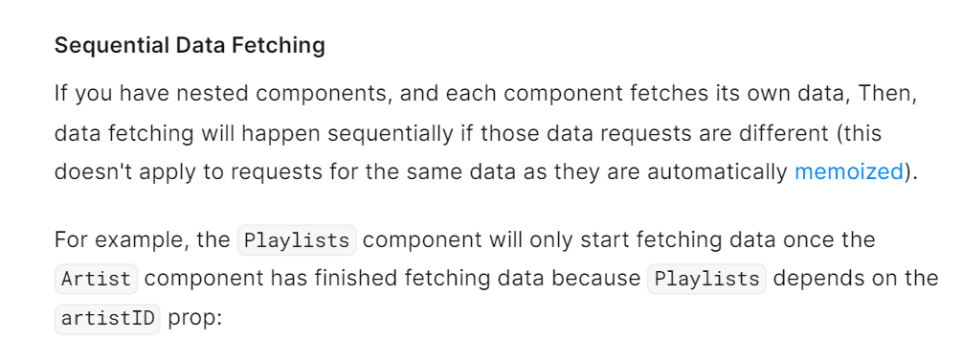

Slide 68
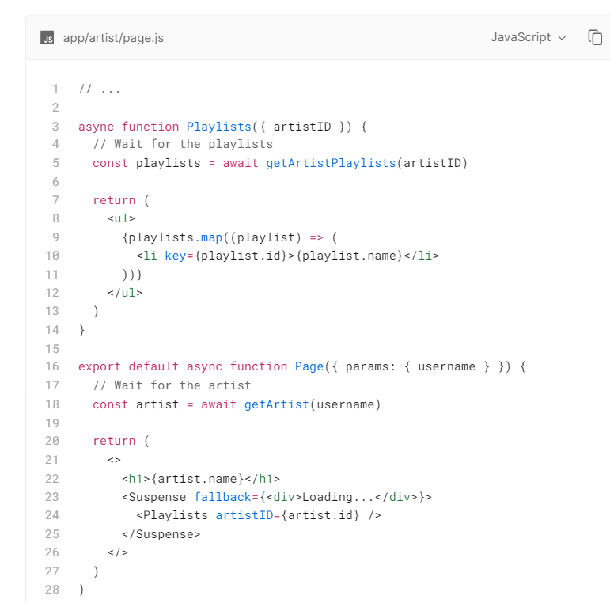

Slide 69
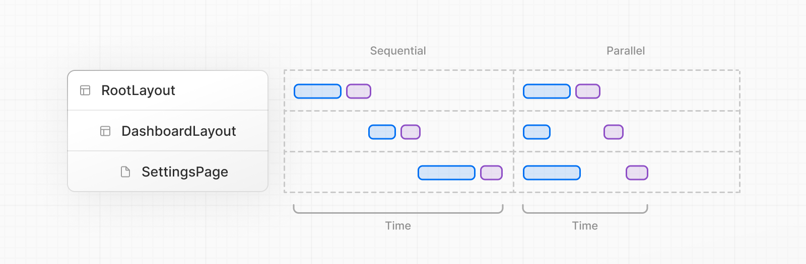

Slide 70

Thank You
Subramanian Murugan

